Slide 1
TALK TO ME –
SPEAK THE LANGUAGE OF YOUR NEW COUNTRY
Liisa Peltomaa and Anne-Marie Salonen
DKG Finland State and Gamma Chapter in Turku
DKG Regional Conference in Baden-Baden
2011

Slide 2
DKG Γ Chapter Finland
and
Association Daisy Ladies
Aim to participate in cooperation
in which
Knowledge is power
into which
Language is the key
Notes:
We are glad you are here!
Presenters may consider sharing personal stories of the impact of the organization on their own personal and/or professional lives.

Slide 3
Association Daisy Ladies
A social network for immigrant women
in Finland founded in 2002 to
Bring cultures together and support each
one’s own cultural identity*
Act as an association that develops every
kind of equality*
Increase possibilities for education and
Employment*
Language teaching*

Slide 4
Staff
2 salaried workers
Part-time and long-term volunteers from women’s organizations like DKG and UNIFEM

Slide 5
Association Daisy Ladies
The ways it works
Information and advice
Member gatherings
Supporting each other
Lectures, seminars, workshops, visits and
courses*

Slide 6
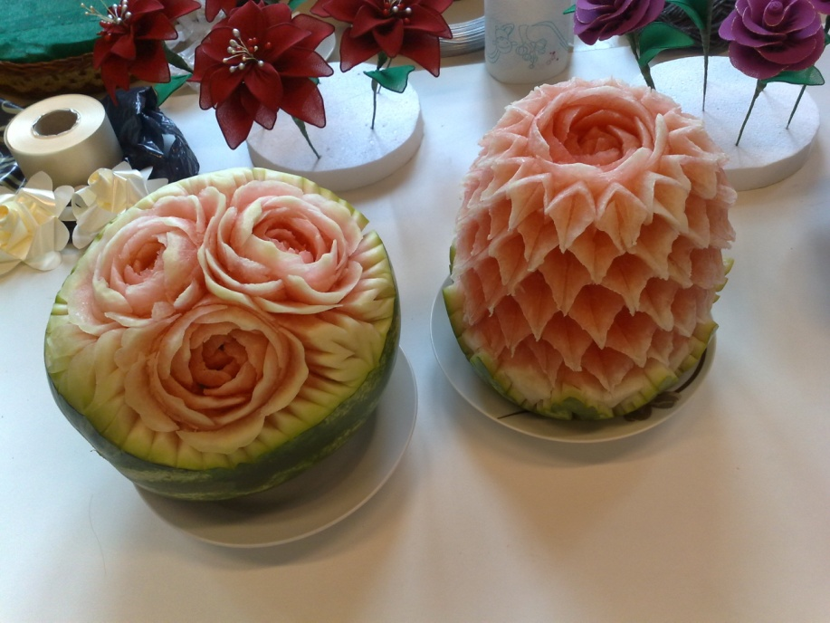
Association Daisy Ladies
Activities together
Handicrafts
Sports
Cooking
Fun
Studies about
Finnish society
Celebrating events*

Slide 7
Selection of participants
on application
50-60 participants per year
length of attendance few months up to one year
length of attendance few months up to one year*

Slide 8
Methods
Interview – getting to know each other
Distributing lists of terms and phrases
Repeating after the instructor/ and reading aloud all together
Questions and replies by instructors and by each participants
Pictures, gestures and sign language
Aim to activate everyone *

Slide 9
Signitures of the participants

Slide 10
Content of our course
Date | Content | Lecturers
2.3.2009 | Get together | Liisa Peltomaa, Liisa Seppälä
9.3.2009 | Housing in Finland | Liisa Peltomaa, Kaarina Pyhälahti
16.3.2009 | Family | A-M Salonen, Liisa Seppälä
23.3.2009 | Question hour | Kaarina Pyhälahti, Kristiina Sillman
30.3.2009 | Easter time | A-M Salonen, Liisa Seppälä
6.4.2009 | Food and Finnish menu | Eva Hakkarainen, A-M Salonen
13.4.2009 | Singing hour with Finnish songs | Seija Somerpalo, Liisa Peltomaa
20.4.2009 | Clothing in Finland | A-M Salonen, Eva Hakkarainen
27.4.2009 | Life cycle and children | Seija Somerpalo, Kristiina Sillman

Slide 11
New themes this year
Health and illnesses
Education
Customs and habits
Colours
Numerals
Festivities and religious holidays
Traffic signs
Energy

Slide 12
Countries of the participants
There were women from
Afganistan
China
Irak
Iran
Korea
Kosovo
Morocco
Nepal
Russia
Somalia
Turkey
Thailand
Vietnam

Slide 13
Funding
City of Turku
Finland’s Slot Machine Association (RAY)
The Social Insurance Institution of Finland
Ministry for the Interior Affairs and Ministry of Education and Culture

Slide 14
Problems
Differences in the intellectual levels of the ladies – some well educated and some almost illiterate
Groups are too large
Much time spent on interpreting*

Slide 15
What they like and not like
Understanding the text

Slide 16
What they like and not like
Understanding the text

Slide 17
Photos of Association Daisy Ladies

Slide 18
Photos of Association Daisy Ladies

Slide 19
Photos of Association Daisy Ladies

Slide 20
Thank you for your attendance!
Baden-Baden 2011

